Slide 1

Crypto Portfolio Management: Track & Analyze Your Investments
The ultimate tool for crypto investors. Simplify tracking, analysis, and optimization with our comprehensive platform.
SUBMITTED BY
M DEVA
192124170

Slide 2
The Growing Need for Crypto Portfolio Management
The Crypto Portfolio Manager is a digital tool that helps investors track, analyze, and optimize their cryptocurrency holdings across multiple wallets and exchanges. It automates tracking, provides insights, and simplifies tax reporting.
Market Growth: The crypto market cap surpassed $2.6 Trillion (March 2024).
Challenges in Crypto Portfolio Management
Fragmentation – Assets spread across different platforms (Binance, Coinbase, Metamask, etc.).
Diverse Investments: Users hold assets across multiple exchanges, wallets, and blockchains.
Complexity – Hard to track profits, losses, and transaction details.
Manual Tracking Issues: Traditional tracking is time-consuming, error-prone, and inefficient.
Tax & Compliance Issues – Users must comply with tax regulations in various countries.
Security Risks – Managing API keys and wallet connections securely is crucial.

Slide 3
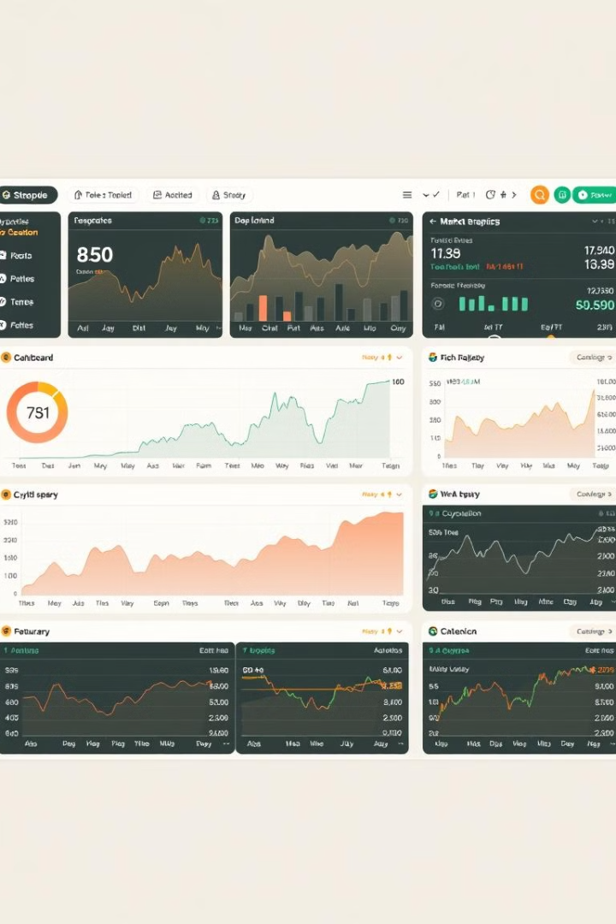



Key Features: Real-Time Tracking
Live price updates from 50+ exchanges. Supports 10,000+ cryptocurrencies. Portfolio value displayed in multiple fiat currencies. Automated transaction import via API or CSV.
Live Prices
Automated Import
Fiat Support

Slide 4
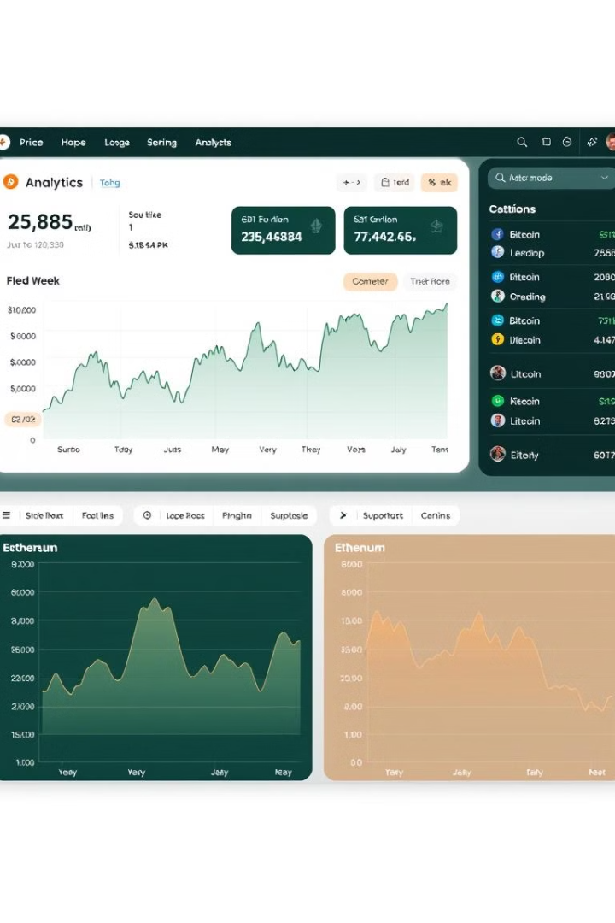



In-Depth Analytics
Customizable dashboards with key metrics. Profit/loss analysis with transaction breakdown. Historical performance charts with adjustable timeframes. Asset allocation pie charts.
Customizable dashboards to track key metrics.
Profit/Loss analysis with a detailed transaction breakdown.
Historical performance charts with adjustable timeframes.
Asset allocation visualization (pie charts, bar graphs).
Custom Dashboards
Profit/Loss Analysis
Historical Charts

Slide 5
Advanced Reporting & Tax Compliance
Automated tax report generation (CSV, PDF). Support for FIFO, LIFO, and Average Cost basis. Integration with tax software. Audit trail of all transactions.
Automated tax report generation (CSV, PDF).
Support for FIFO, LIFO, and Average Cost basis.
Integration with tax software (TurboTax, Koinly, Coin Tracker, etc.).
Audit trail for tracking all past transactions.

Slide 6








Security & Privacy
Non-custodial: We never have access to your funds. Military-grade encryption for data protection (AES-256). Two-factor authentication (2FA). Regular security audits.
Two-Factor Authentication
Encryption
Non-Custodial
Security Audits

Slide 7




Maximize Returns
Identify profitable trading opportunities. Optimize asset allocation for risk management. Make data-driven decisions. Save time on manual tracking.
Trading Opportunities
Risk Management
Data-Driven Decisions

Slide 8

Simplify Tax Reporting
Accurate tax reports in minutes. Avoid costly errors and penalties. Stay on top of evolving regulations. Reclaim hours spent on manual calculations.
Accurate tax reports generated in minutes.
Compliance with global regulations (IRS, HMRC, etc.).
Avoid costly penalties by staying compliant.
Accurate Reports
Generate compliant tax reports quickly.
Avoid Penalties
Reduce the risk of tax errors and penalties.

Slide 9
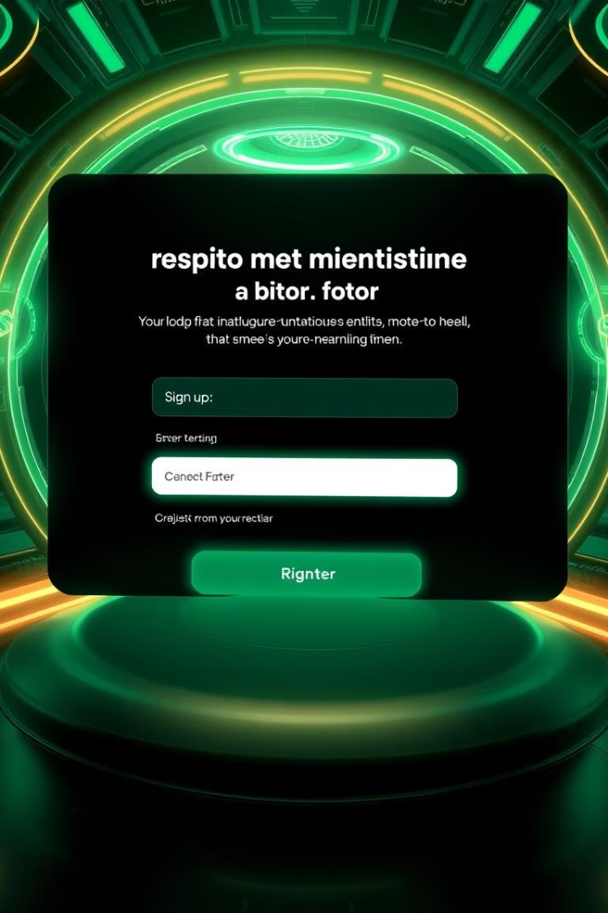
Get Started Today
Sign up for a free trial. Upgrade to a premium plan for advanced features. Join our community of crypto investors today.
1
2
Sign Up
Upgrade
Start with a free trial.
Unlock premium features.
3
Join
Connect with crypto investors.

Slide 10

Thank You

